Slide 1

,The Web Framework that Rocks !
November 18, 2013
Karim DJAAFAR
JASMINE CONSEIL Group

Slide 2

Who am I
Exp : JSP/Servlet , Tapestry , Spring/Hibernate/JavaEE 6 , EJB3, Grails , Play! Framework
Team Leader of JASMINE CONSEIL
http://twitter.com/djafaka
kdjaafar@jasmineconseil.com

Slide 3
The Problem with JEE
Java itself is a very generic programming language and not originally designed for web application development
Traditional Web Development :
  Slow development cycle, too much configuration, hidden cost …
JEE Technology introduce and particularly JSF, a wrapper on HTTP protocol. He tries to extend the basic functionality of the Web to creates state full applications
  The consequences=> Too much complexities en hidden processing
  For may junior developer, what does the framework looks like magic
OVER ARCHITECTED !

Slide 4
What is Play
Play was built “by web developers, for web developers”
Play is for productive web developers
Play if flexible : almost everything is pluggable, configurable, and customizable
Play is extensible : it’s easy to integrate a Play framework application with other (legacy) systems
Large-team applications
Security

Slide 5
Play Architecture
HTTP Request
Router
invoke
HTTP Response
Controller
Action
Action
Action
render
retrieve
update
Views
Model
Persistent
storage
XML
HTML

Slide 6
Play key features
Play is not a JEE Framework !
Pure Java
Based on an HTTP simple server (http://mina.apache.org/)
  Totally independent of Java EE environment :
    No configuration: download, unpack and develop
  RESTful
  Simple Stateless MVC Architecture
  No session
  Similar to Rails / Django
  Rich domain model

Slide 7
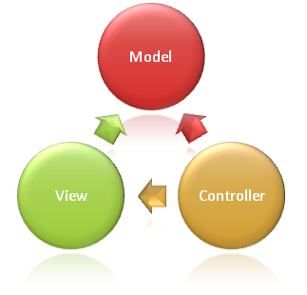
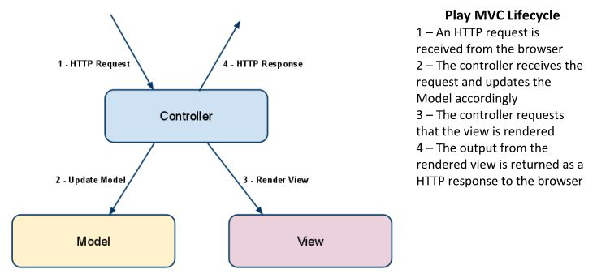
MVC Based

Slide 8



Play! A variety of technologies
CoffeeScript
Sbt
Less
Ebean
Google Closure Compile
Jdbc
Yaml
Akka
Memcached
Heroku
Selenium
Logback
Junit
Notes:
Au centre : Java et Scala.
Mais Play! s’appuie sur pas mal de technologies différentes :
- Soit en interne pour ses mécanismes
- Soit en offrant les interfaces pour les intégrées aiséments

Slide 9

Big Principles
  Web Based Architecture (REST principle)
  Full-Stack Framework
      Cover all the steps : from development to production : Fix and reload !
      Propose an API required for all the functionalities of a Web application
  Productive
      Based on simple and predicted concepts
      Minimal Architecture
      Developer can interact with is web application through a console
  High scalability
    Stateless framework
    Few instantiations of objects
  Test based
    Integration of test tools (Junit, Selenium)
    Helper to help develop test case
Notes:
REST :
URL simple et Bookmarkable
Utilisation et respects des actions du protocoles HTTP (GET, POST, PUT, DELETE, HEAD...)
Stateless (deux appels HTTP sont totalements indépendants).
Scalabilité = Capacité de montée en charge.

Slide 10
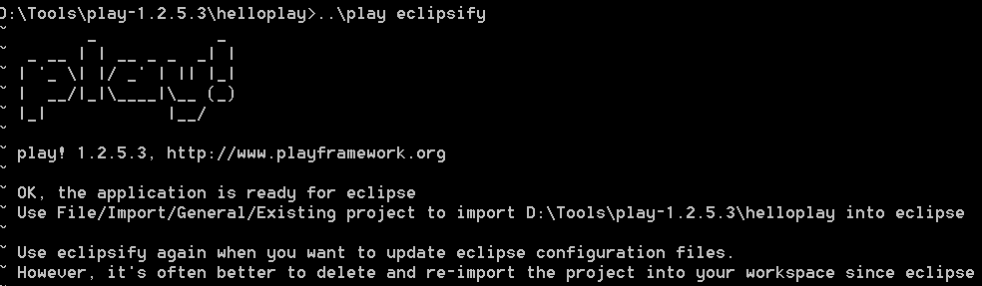
Setting up Eclipse
Play makes it easy to import your applications into most well-known IDEs by including commands that will set up a project for you
Play comes with support for Eclipse and generate all the necessary files for you when you run the eclipse from the Play console

Slide 11
Play an Example in little steps :
Create, Run, and Test

Slide 12
Creating and starting an application
First things first, we need to set up and configure the Web Application, the directory structures and create the Java and HTML files
Play does it all for you in one command line argument
Play will ask you what the name is for your application, so we will just enter "Hello Play" and we are done !

Slide 13
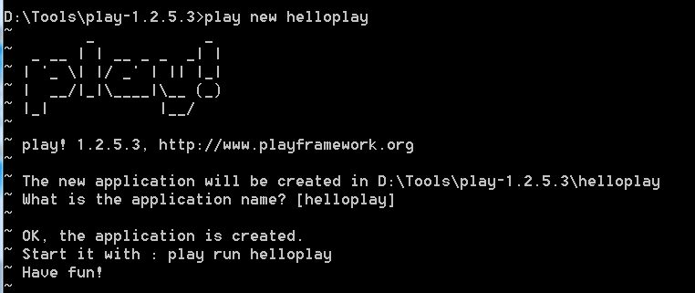
Play : step 1, Create
o To start the console, run the play command in the application directory without an additional command :
$ play new helloPlay

Slide 14
Application Directory Structure
The play new command creates a new directory helloplay/ and populates it with a series of files and directories. The most important are as follows.
app/ contains the application’s core, split between models, controllers and views directories. This is the directory where .java source files live.
conf/ contains all the application’s configuration files, especially the main application.conf file, the routes definition files and the messages files used for internationalization.
project/ contains the build scripts. The build system is based on sbt. But a new play application comes with a default build script that will just works fine for our application.
public/ contains all the publicly available resources, which includes JavaScript, stylesheets and images directories.
test/ contains all the application tests. Tests can be written as JUnit tests.

Slide 15
Play, Step 2: Run
$ play run
http://localhost:9000
conf/routes
app/controllers/Application.java
app/views/Application/index.html
template: app/views/main.html
write an error then refresh, Woo~
write index.html

Slide 16
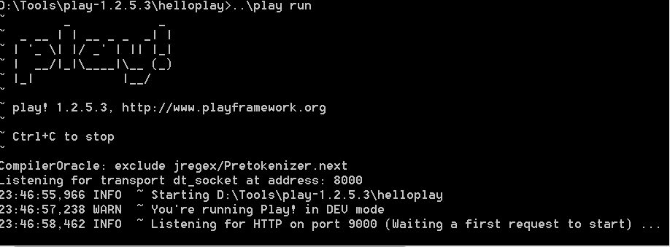
Play Run

Slide 17
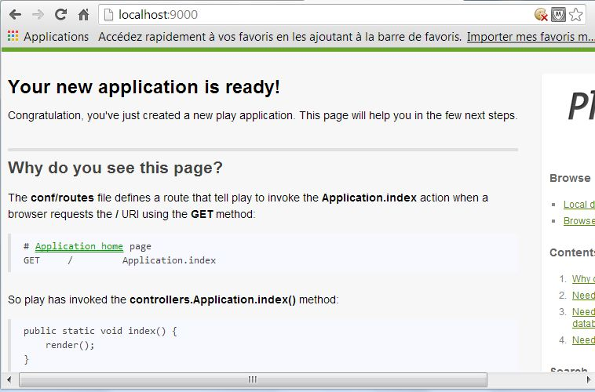
Play, Run
http://localhost:9000

Slide 18
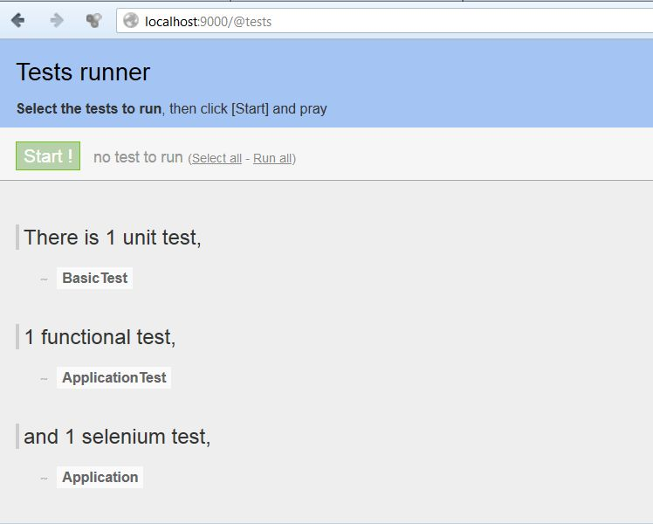
Play, Test
http://localhost:9000/@tests

Slide 19
Customize Play
The next step to building our Hello Play application is to replace the default page that you saw when first started the application with our custom view
The Java files are compiled automatically by Play behind the scenes, and there is no need to deploy or package any of your code for your changes to take effect, so the server should stay up and running while you are developing your code.

Slide 20
Writing the View
The next step to building our Hello World application is to replace the default page that you saw when first started the application with our custom view
Navigate to the View folder (helloworld/app/views/Application) and open index.html in your chosen Editor (vi or notepad++ will do the job just fine)
You will see the following code:
  #{extends 'main.html' /}
  #{set title:'Home' /}
  #{welcome /}
Next enter the following line at the position where you deleted the welcome tag
<h1>Hello Play !</h1>

Slide 21
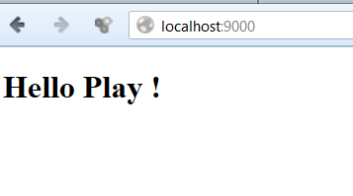
Customize the View
Refresh your browser and you should see the first part of your application running

Slide 22
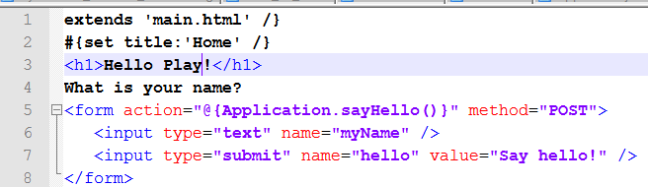
Customize the View (follow)
Next we will ask the user what their name is by adding a form to the page. We will just add one text input element on the form and a submit button
Your code should now look like the following.

Slide 23
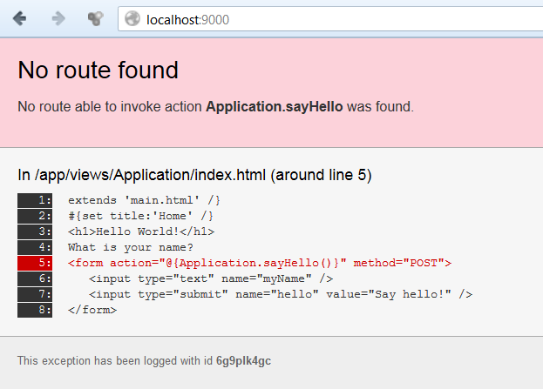
Customize the View (follow)
Let’s refresh the browser and see what happens?
Oh, an error !
In the browser you will see the details of the error, just like this.

Slide 24
Creating a Controller
A controller is the part of an MVC (Model View Controller) application that carries out the logic for the application
By default, Play creates a controller for us to display the index page. Open the controller in your Editor by navigating to (helloplay/app/controllers/) and opening Application.java.

Slide 25
Modify the Controller
You will see a couple of lines of code that display the index page
We now need to add a method to respond to the form submit. In our form that we just created, we were sending the request to Application.sayHello(), so we need to create a new method called sayHello
Your Application.java file should now look like this

Slide 26
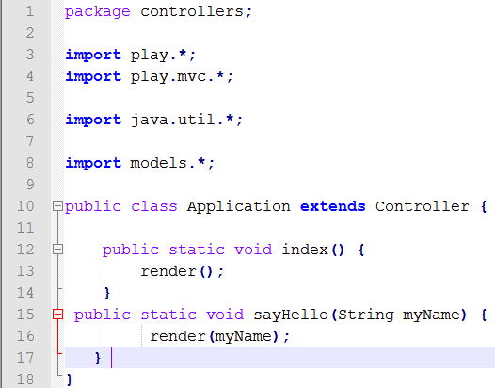
Modify the Controller

Slide 27
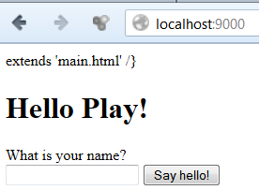
Modify Controller
If you save the file and refresh your browser the error should have disappeared, and you should now see your Hello World application waiting for your input
If you click the submit button you should once again get another error telling us that Application/sayHello.html does not exist
Let’s examine the code that we have created to understand why we get this new error.

Slide 28
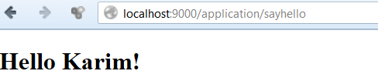
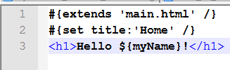
Last customization
Go to (helloworld/app/views/Application) and create a new file called sayHello.html
Enter the following code in the file
Refresh your browser and you have completed your very first Play Framework application. Well done ! You did it all by creating 12 lines of code…

Slide 29
Customizing the Model
create the data model
use Hibernate but have no configuration
play.db.jpa.Model = JPA + helper(e.g. id)

Slide 30
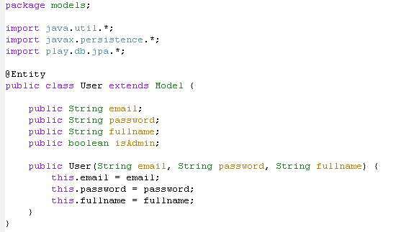
app/models/User.java

Slide 31
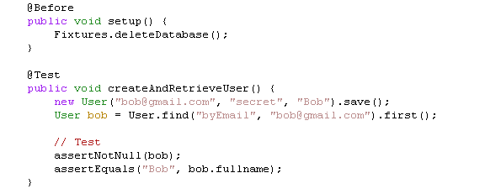
test/BasicTest.java

Slide 32

app/models/User.java

Slide 33
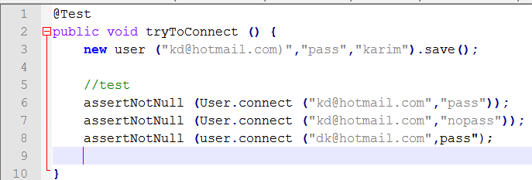
test/BasicTest.java

Slide 34
Play 2.0 and scala ...

Slide 35
Resources
http://www.playframework.org/
http://www.playframework.org/2.0

Slide 36
Thank you!

